Slide 1
Applied Machine Learning and Data Mining
Module Introduction
Dr. ALAA MOHASSEB

Slide 2


About Me
Dr. Alaa Mohasseb
Module coordinator/ lecturer
Senior Lecturer
MSc AI/ML Course Leader
School of Computing
University of Portsmouth
1.31 Buckingham Building
Portsmouth PO1 3HE
Email: alaa.mohasseb@port.ac.uk

Slide 3
About the Module
Year long module
1st teaching block [TB1] : 12 weeks x 2 hours
2nd teaching block [TB2]: 12 weeks x 2 hours

Slide 4
Module Objectives
Provide applied knowledge of the main methods of machine learning with special focus on data mining.
Use data mining toolkits, including how to visualise data and interpret results.

Slide 5
Learning Outcomes
Apply a comprehensive understanding of current advanced methods and techniques in data mining.
Critically analyse and evaluate the performance of different data mining techniques.
Describe how data mining design and implementation methods could be used to solve real-world problems.
Interpret and analyse data mining results

Slide 6
Topics to be covered in TB1 and TB2 (Lecture/Practical)
Topic | Practical
Introduction to ML & DM | Introduction to Juypter & ML Libraries
ML in the Real World: ML Applications | Getting started with Juypter and python
Data understanding | DataFrame Functions
Data preprocessing | Data preprocessing
Data Analysis | Data Exploration and Visualization
Supervised vs. unsupervised Learning
Classification: NB, KNN, SVM | NB, KNN, SVM
Classification: DT, RF | DT, RF
Classification: Regression | Regression
Model Evaluation | Classification Evaluation
Imbalance Data (SMOTE) | Handling Imbalanced Data
Clustering: K-Means | K-means
Clustering: Hierarchical Clustering | Hierarchical Clustering
Clustering: DBSCAN | DBSCAN
Cluster Evaluation | Cluster Evaluation
Association Rule | Association Rule

Slide 7
Assessment
Presentation 30%
The Presentation tasks will include:
In-depth exploratory data analysis such as:
Data Overview and Cleaning
Data Visualization
Find trends and patterns
Coursework 70%
The coursework tasks will include:
Data understanding, prepossessing and analysis;
Build a machine learning model;
Evaluate and visualise the results

Slide 8
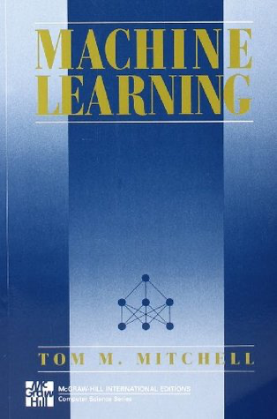
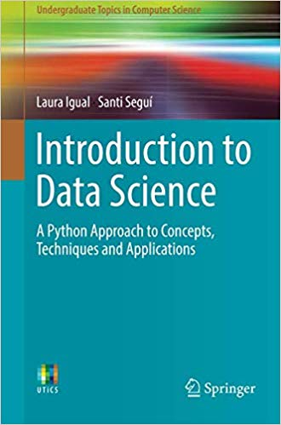
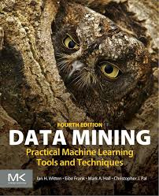
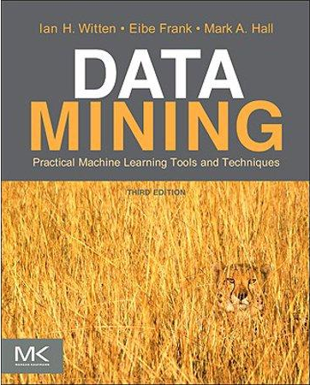
Books - Free Online / University Library

Slide 9
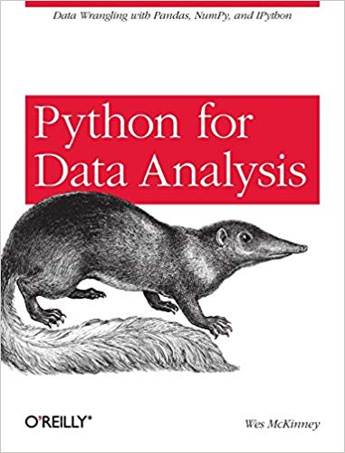
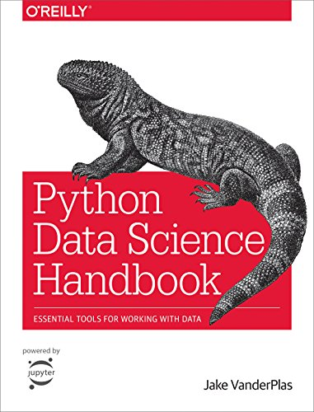
Practical Books

Slide 10
Thank you!

